Slide 1
Group Pi
Day 3

Slide 2
Cyber Patriot Exhibition Round
Completed both Windows 7 and Ubuntu
Team averaged 100 points on both challenges

Slide 3
Cyber Patriot Exhibition Round
For each section we were given a scenario where we would have to use our knowledge of the operating system we were currently working on. We were then given some easy to identify and other more subtle clues as to the problems with the computer that we’d have to fix

Slide 4
Cyber Patriot Exhibition Round
Windows 7:
Remove former Employee accounts
Password Protect user accounts
Disable guest account
Keep a password history
Remove prohibited mp3 files
2 Security questions
Where were the mp3 files?
Which accounts were removed?
Disable Telnet
Disable FTP
Uninstall “web server” and delete all associated files

Slide 5
Cyber Patriot Exhibition Round
Forensic questions correct - 20 pts
User accounts have secure passwords - 20 pts
Check for updates daily - 20 pts
User “Alcorn” is no longer an admin - 20 pts
Apache is disabled or removed - 20 pts

Slide 6
Building a Computer
The main components you will need:
Chassis
Motherboard
CPU (computer processing unit)
PSU (power supply unit)
HDD (hard disk drive)
RAM (random access memory)
Fans, Heatsink, and Cables

Slide 7
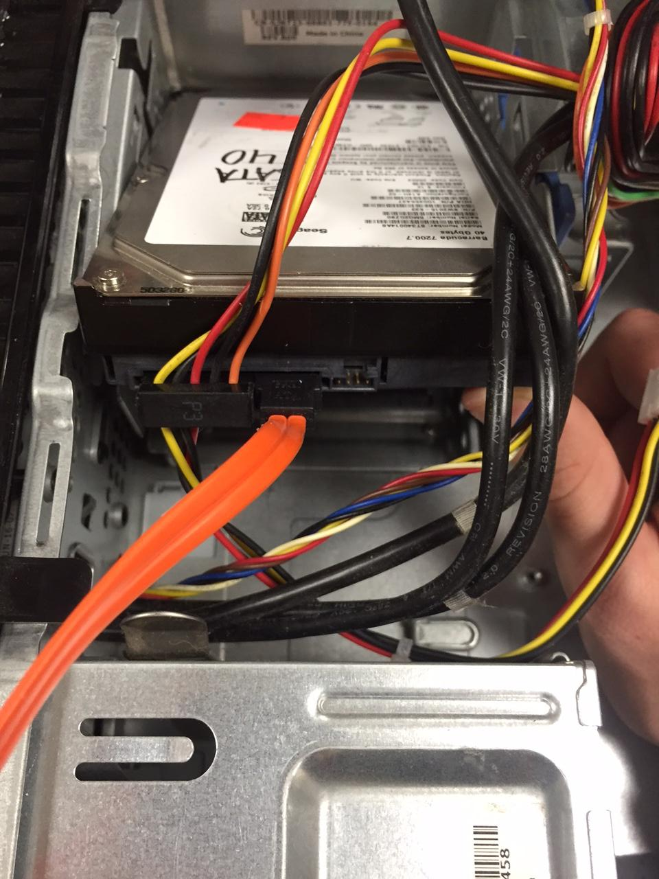
Step One
Determine if any parts need to be put in before the motherboard. For us it was the PSU and the HDD.

Slide 8
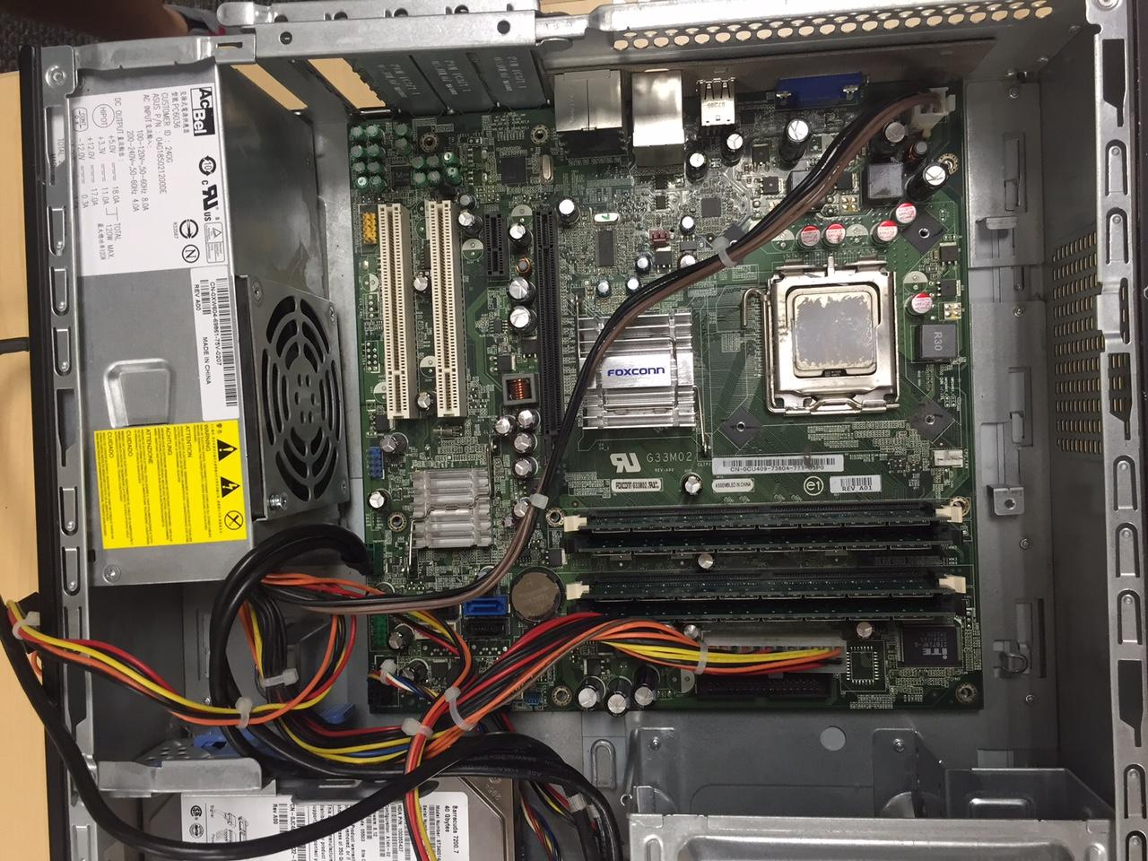
Step Two
Next place the RAM sticks, CPU, and heatsink on the motherboard. Then install the motherboard into the chassis. Connect the SATA and and power supply cables.

Slide 9
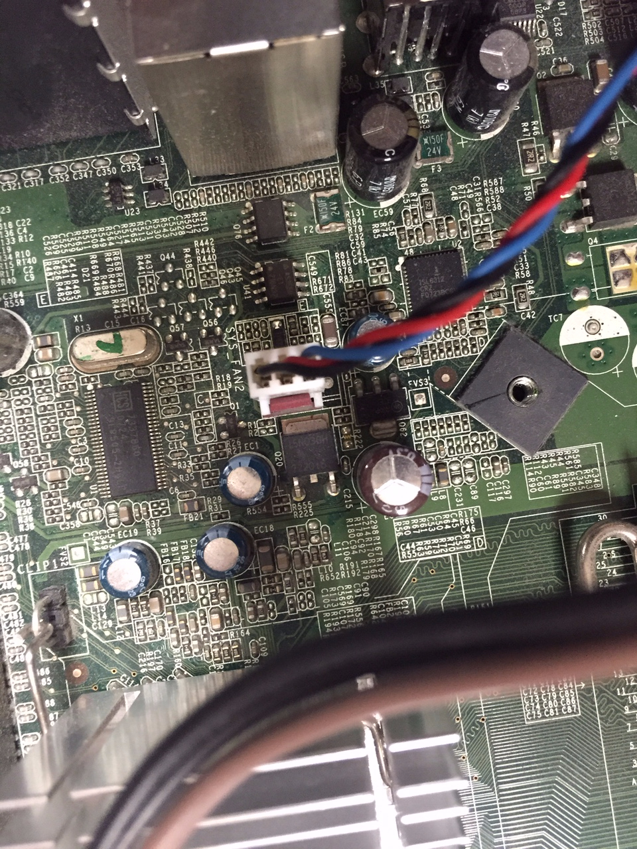
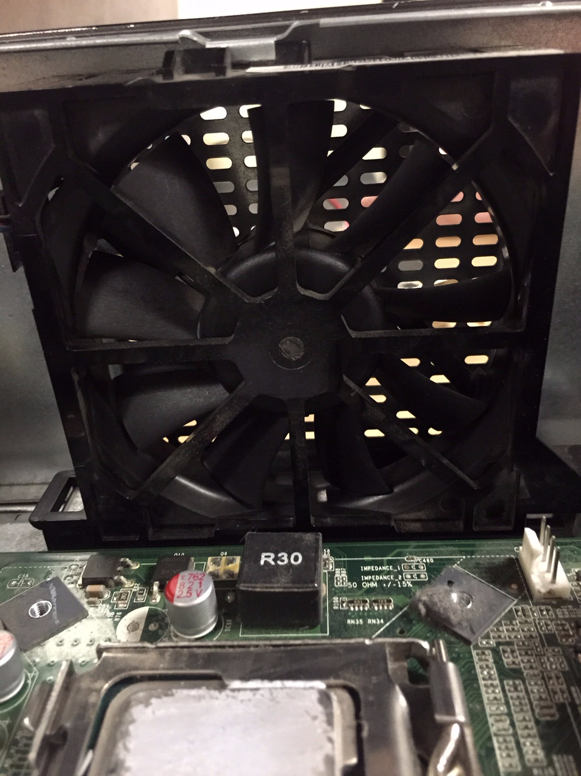
Step Three
Finally install the chassis fans.

Slide 10
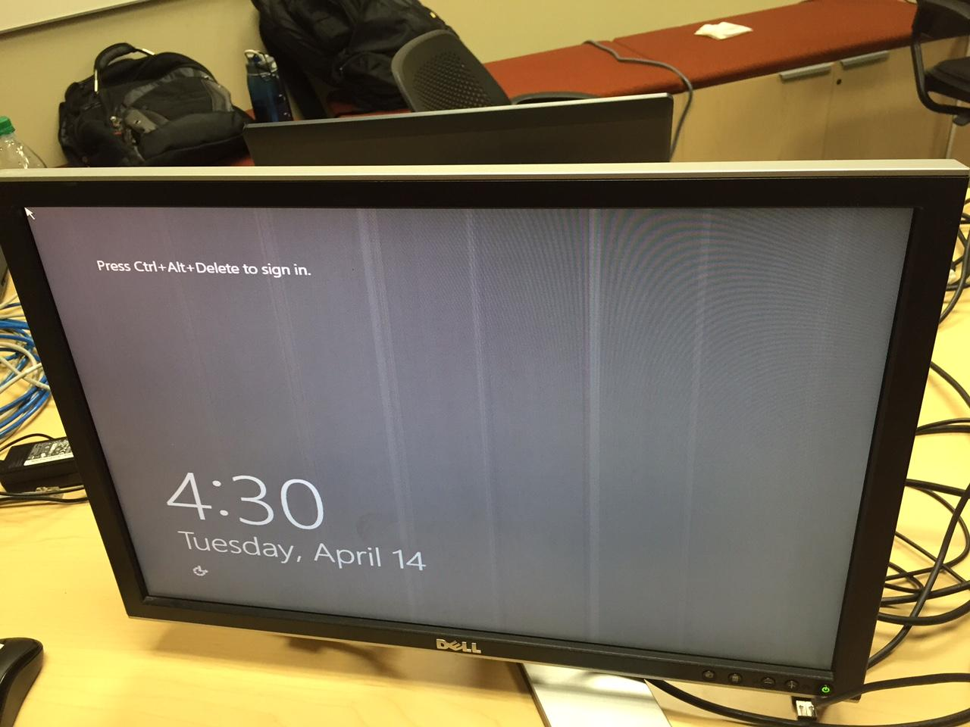
Step Four
Plug in power and peripherals. Turn it on. See if it posts.

Slide 11
Difficulties
We ran into a BIOS password on initial boot up, so we pulled out the BIOS battery and moved over the jumper.

Slide 12
References
Initial Lecture
http://www.wikihow.com/Break-a-BIOS-Password

